Slide 1
Azure IoT Central
In A Nutshell

Slide 2

Wat is IoT Central
IoT Central is een Microsoft Azure-service die bedrijven faciliteert bij het beheren, verzamelen van gegevens en analyseren van IoT-apparaten voor operationele optimalisatie.

Slide 3
Wat is IoT Central
Cloudbased platform
Manage Iot devices
Realtime monitoring
Scalability
Flexibility
Notes:
- Cloudbased platform
- azure
- out of the box portal
- organise iot devices
- register devices
- group devices
- put devices in organizations
- manage device templates => capababilities
- realtime monitoring
- realtime data wanneer gemapped
- dashboards
- widgets
- charts
- adx
- scalability
- iot hub load balancing
- flexibility
- api management
- azure eco system exports

Slide 4
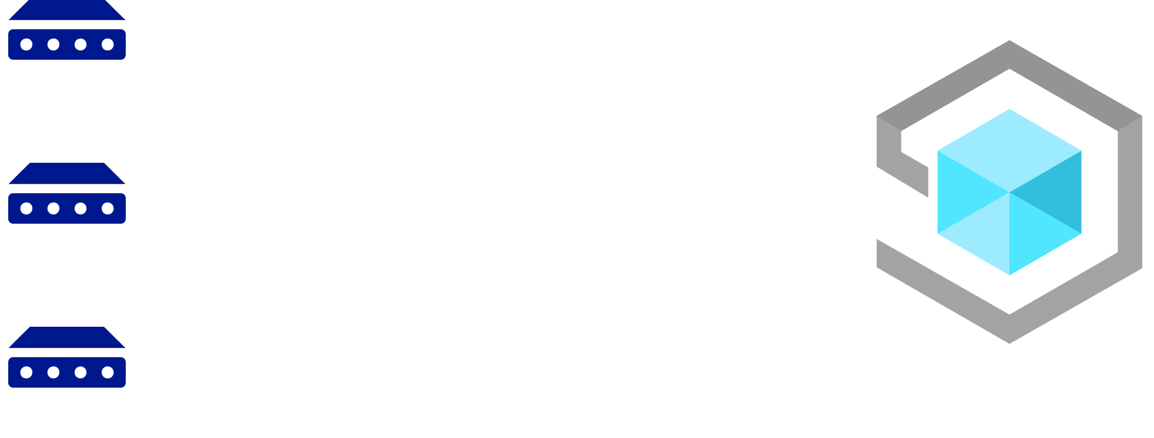
Devices
Iot Devices
Iot Edge Devices

Slide 5
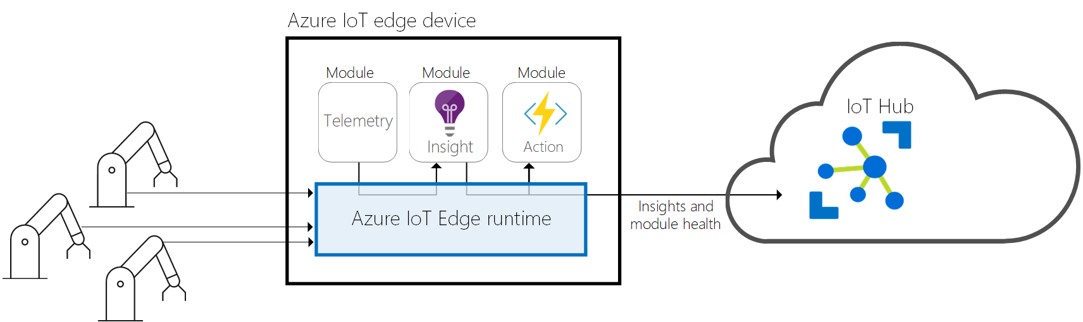
Devices
Iot Devices
Iot Edge Devices

Slide 6
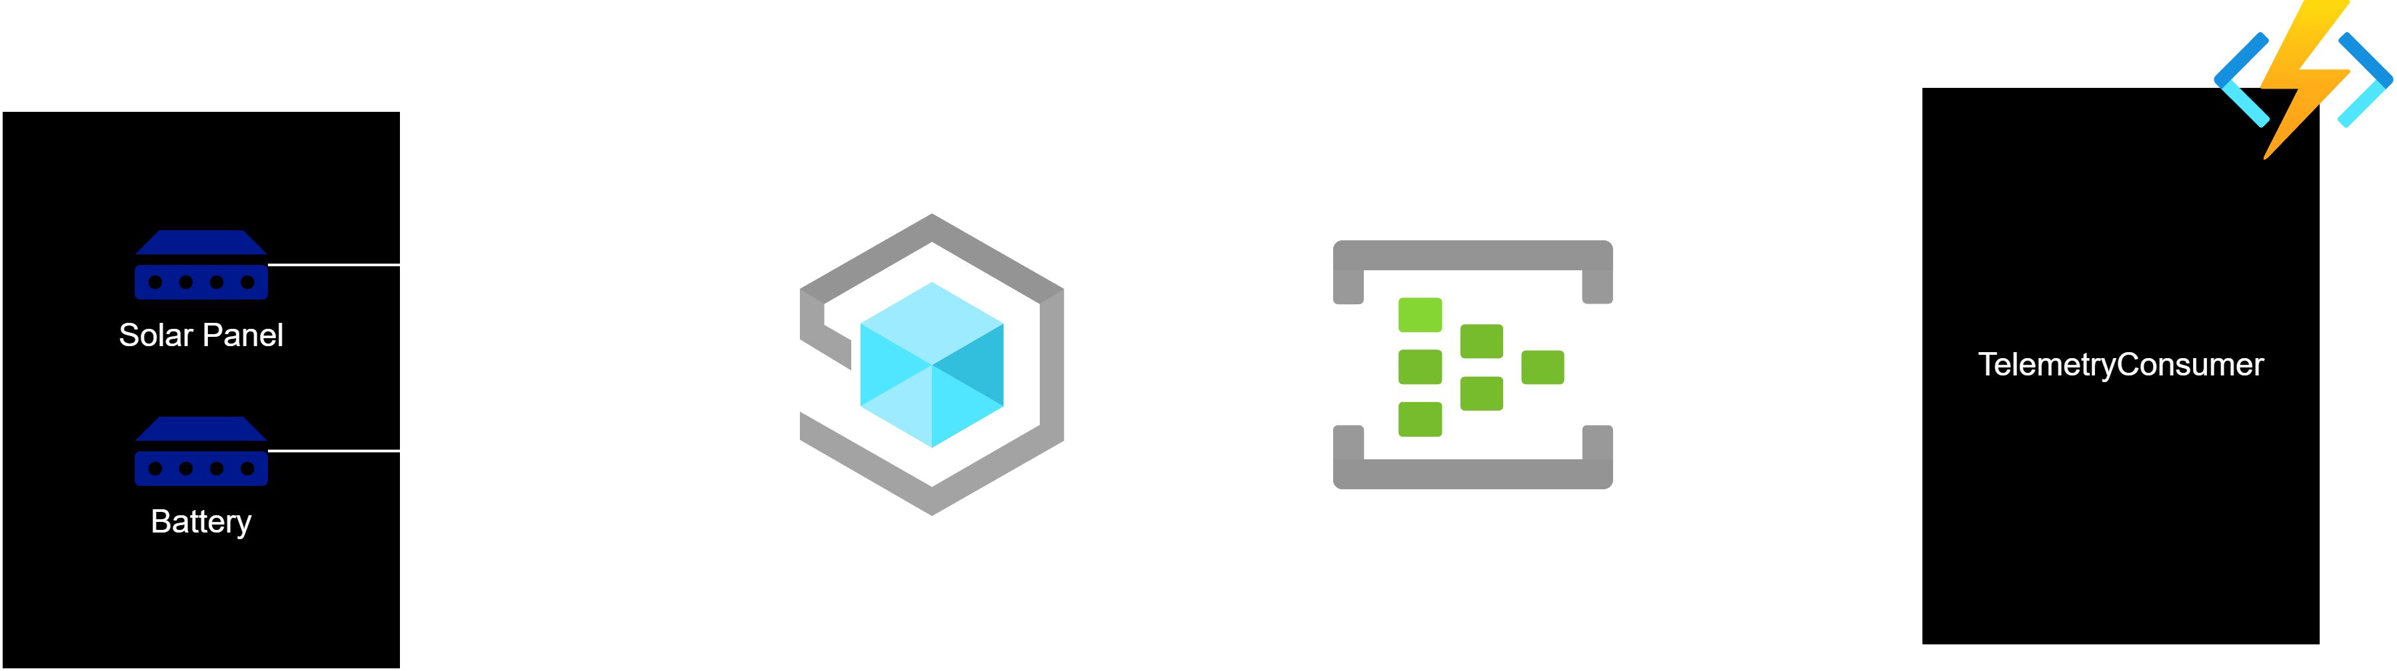
Demo

